Slide 1
IoT BASED SYSTEM FOR SAFETY AND HEALTH MONITORING OF INDUSTRIAL WORKERS
Guided By
Mr. Kartik S Prakash
Dept. of ECE, TKMCE, Kollam
Presented By
Akhilesh K ( B16ECB07 )
Alan A Thomas ( B16ECB09 )
Anekha K ( B16ECB12 )
Vaishakh E ( B16ECB57 )
PROJECT BATCH :5

Slide 2
CONTENTS
Contents
Introduction
Literature Survey
Proposed Work
General Architecture
Wearable Network
IoT Gateway
IoT Network
Network Implementation
Implementation
Architecture
System Hardware
System Software
Results
Budget
Conclusion
References

Slide 3
INTRODUTION
PROBLEM STATEMENT
Industrial workers suffer from the health issues caused by the working conditions
Also, industries pose some serious safety concerns like skin cancer due to UV radiation and even death due to inhalation of carbon monoxide
Hence, it is required to monitor the working conditions to ensure safety and good health of workers

Slide 4
SOLUTIONS
Wireless body area networks for healthcare systems
Self-Powered Wearable IoT Sensor Network for Safety Applications
Secure IoT-based modern healthcare system using body sensor network
IoT-cloud Based Wearable ECG Monitoring System for Smart Healthcare
Wearable wireless sensor network for indoor smart environment monitoring in safety applications

Slide 5
LITERATURE SURVEY
“An internet-of-things (IoT) network system for connected safety and health monitoring applications” Sensors, vol. 19, no. 1, p. 21; 2019, F. Wu, T. Wu, and M. R Yuce
“A Self-Powered Wearable IoT Sensor Network for Safety Applications Based on LoRa”. IEEE Access 2018, 6, 40846–40853; 2018, Wu. F, Redouté, J.M. Yuce, M.R. WE-Safe
A Wearable Wireless Medical Sensor Network System towards Internet-of-Patients. In Proceedings of the 2018 IEEE Sensors, New Delhi, India, 28–31 October 2018. Wu, T.; Redouté, J.M.; Yuce, M.R.
An IoT-cloud Based Wearable ECG Monitoring System for Smart Healthcare. J. Med. Syst. 2016, 40, 286. Yang, Z.; Zhou, Q.; Lei, L.; Zheng, K.; Xiang, W.

Slide 6
PROPOSED WORK
IoT based system for health and safety monitoring of industrial workers using Wearable Body Area Networks (WBAN).
Connected Lora WAN which enables transfer of collected sensor data to the cloud with low power consumption and high range.
Use of both Safe node and Health node for monitoring the factory worker.
Data is stored in the ChirpStack network server and graphically visualized in Grafana.

Slide 7
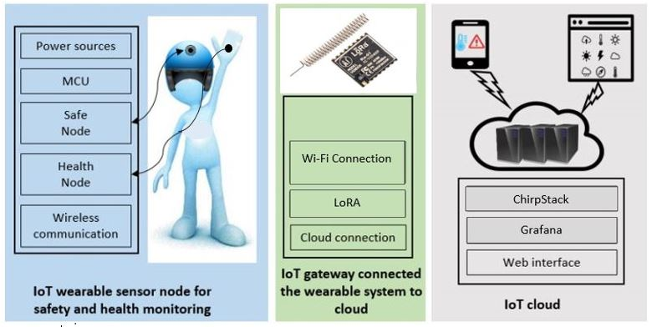
GENERAL ARCHITECTURE

Slide 8
WEARABLE NETWORK
Two wearable sensor nodes on each subject.
The Health Node comprises a Node-MCU module enabling WBAN communication, a sensor for heart rate monitoring and a body temperature sensor.
The Safe Node comprises a Temperature & humidity sensor, an Air Quality sensor, the Node MCU for communication within the WBAN and LoRa for transmission in the LPWAN.
The MCU in the Safe Node is responsible for receiving sensor data from the Health Node within the WBAN, which will be transmitted to a remote gateway via the LoRa network.

Slide 9
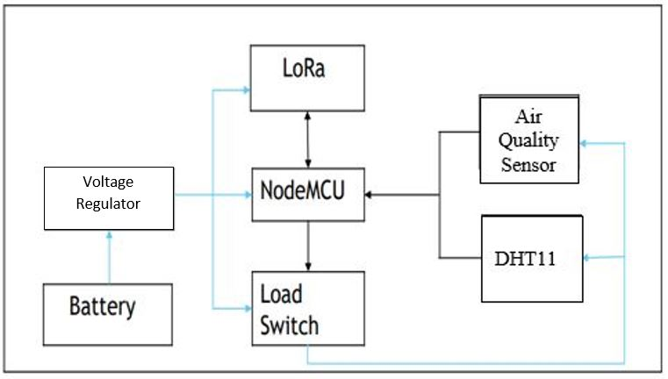
SAFE NODE
ENVIRONMENTAL SENSORS
MQ135 – Air Quality Sensor
DHT11 – Temperature and Humidity Sensor

Slide 10
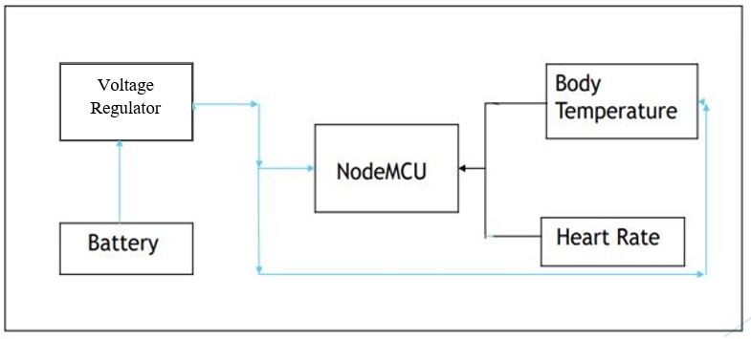
HEALTH NODE
PHYSIOLOGICAL SENSORS
Pulse Rate Sensor – Plug-and-play heart-rate sensor
LM35 - Body temperature sensor

Slide 11
IoT GATEWAY
It connects the wearable network to the IoT cloud. The gateway consists of a LoRa module.
Lately LoRaWAN has been increasingly popular in Internet of Things (IoT) applications. LoRaWAN offers low power, low payload Internet connection without using WIFI.
LoRaWAN also defines the way in which data is sent around the network, detailing the responses of the its gateways, and the LoRa network server.
It can run on a tiny coin cell battery for years. It is perfect for daily applications that require remote connection and monitoring but does not require high power or data bandwidth.

Slide 12
IoT NETWORK
The IoT cloud server will receive the data from the IoT gateway and stores the data into the cloud database.
The data stored in the database can be accessed later for further analysis.
The ChirpStack open-source LoraWAN Network Server stack provides open-source components for LoRaWAN networks. Together they form a ready-to-use solution including an user-friendly web-interface for device management and APIs for integration.
Grafana is a multi-platform open source analytics and interactive visualization web application.

Slide 13
NETWORK IMPLEMENTATION
There are mainly two networks in the proposed system.
One is in local environments—LPWAN including the WBAN.
The other one is the IoT network connecting to the cloud.
The data from the Health Node and Safe Node will be transmitted to the IoT gateway and then finally to the cloud server.
MQTT (message queuing telemetry transport) can be used in our IoT network system to transfer the information between the gateway and the cloud server.

Slide 14
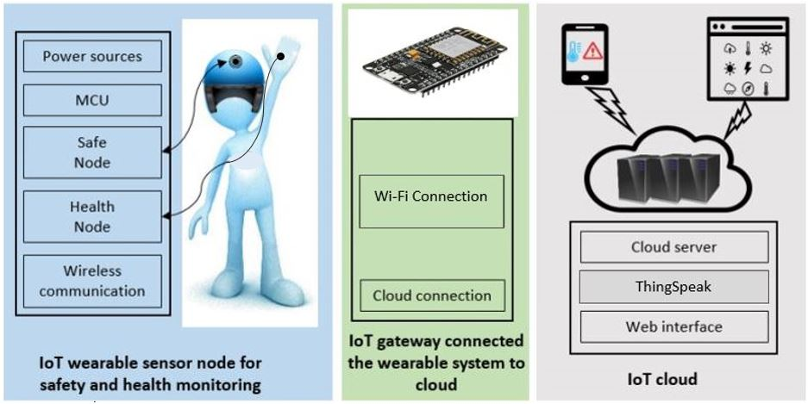
IMPLEMENATION
ARCHITECTURE

Slide 15
SYSTEM HARDWARE
SAFE NODE
ENVIRONMENTAL SENSORS
MQ135 – Air Quality Sensor
DHT11 – Temperature and Humidity Sensor
HEALTH NODE
PHYSIOLOGICAL SENSORS
Pulse Rate Sensor – Plug-and-play heart-rate sensor
LM35 - Body temperature sensor

Slide 16
SYSTEM SOFTWARE
THINGSPEAK
An IoT analytics platform service that allows you to aggregate, visualize, and analyze live data streams in the cloud.
It is an open source platform made for IoT device developers and learners where developers can send and log data to the server, analyze, retrieve and store results using graphs with MATLAB support.
API -Application programing Interface.
There are two API keys generated while creating an account; one is called read API key and another is called write API key.

Slide 17
RESULTS
The physiological data of the worker is collected using the pulse rate sensor and the temperature sensor at the health node.
The environmental data is collected using the air quality sensor and the temperature and humidity sensor at the safe node.
The recorded data by the sensors is further up-loaded to the ThingSpeak.
Different ThingSpeak channels have been used for the respective sensors.
The Graphs are plotted in ThingSpeak according to the sensors data received
An alarm is created in the ThingSpeak interface dashboard to notify any rise in sensor value above the preset threshold level.

Slide 18
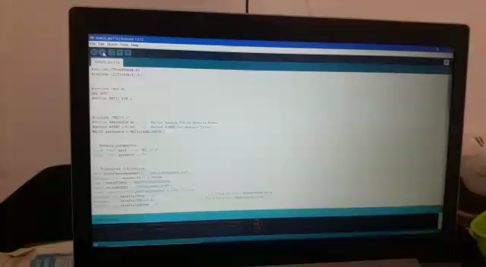

Slide 19
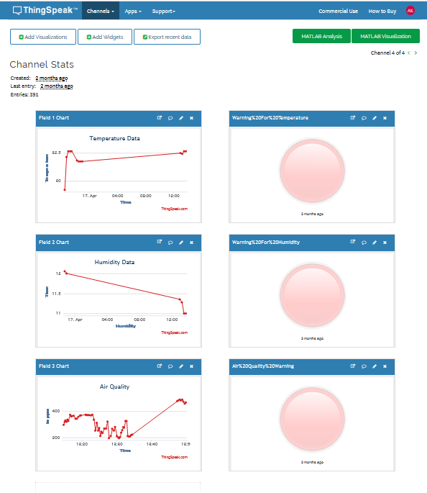

Slide 20
BUDGET
ITEM | MODEL | NO. OF UNITS | PRICE PER UNIT
Air Quality Sensor | MQ135 | 2 | 200
Pulse Rate Sensor |  | 2 | 200
Temperature and Humidity Sensor | DHT11 | 2 | 150
Body Temperature Sensor | LM35 | 2 | 100
Node MCU | ESP8266 | 4 | 400
LoRA Module | SX1278 | 2 | 600
Analog Extender | ADS1115 | 2 | 300
Rechargeable Battery | Lithium - ion | 2 | 500
Helmet |  | 2 | 600
Gloves |  | 4 | 100
Voltage Regulator | SGM2019 | 4 | 20
Load Switch |  | 2 | 30
TOTAL |  |  | 7440

Slide 21
CONCLUSION
The design of an IoT augmented Health Monitoring System for Industrial Workers is presented.
It comprises a WBAN for short-range wireless communication and an LPWAN for long-distance data transmission.
Two sensor nodes, the Safe Node and Health Node, are designed to be deployed in the WBAN to collect the environmental and physiological data of the subject respectively, which will be further sent to an IoT gateway via the LPWAN infrastructure.
The gateway (local server) is designed to perform functions including receiving sensor signals, processing raw data, real-time display, emergency notification, as well as sending data to the Internet cloud server.
The safe node is to be attached to the safety helmet of the workers and health node on their working gloves, so that their data can be constantly obtained without any interference.
By using the LoRaWAN technology, the data of large number of workers in an industry can be monitored simultaneously.
By monitoring the workers’ conditions (both environmental and physiological), it will be possible to alert them about critical situations.

Slide 22
REFERENCES
[1] F. Wu, T. Wu, and M. R Yuce, “An internet-of-things (IoT) network system for connected safety and health monitoring applications,” Sensors, vol. 19, no. 1, p. 21, 2019.
[2] M. R. Yuce, “Implementation of wireless body area networks for healthcare systems,” Sensors and Actuators A: Physical, vol. 162, no. 1,pp. 116–129, 2010.
[3] Wu, F.; Redouté, J.M.; Yuce, M.R. WE-Safe: A Self-Powered Wearable IoT Sensor Network for Safety Applications Based on LoRa. IEEE Access 2018, 6, 40846–40853.
[4] Gope, P.; Hwang, T. BSN-Care: A secure IoT-based modern healthcare system using body sensor network. IEEE Sens. J. 2016, 16, 1368–1376.
[5] Yang, Z.; Zhou, Q.; Lei, L.; Zheng, K.; Xiang, W. An IoT-cloud Based Wearable ECG Monitoring System for Smart Healthcare. J. Med. Syst. 2016, 40, 286.
[6] Wu, T.; Redouté, J.M.; Yuce, M.R. A Wearable Wireless Medical Sensor Network System towards Internet-of-Patients. In Proceedings of the 2018 IEEE Sensors, New Delhi, India, 28–31 October 2018.
[7] Kokalki, S. A., Mali, A. R., Mundada, P. A., & Sontakke, R. H. (2017). Smart health band using IoT. 2017 IEEE International Conference on Power, Control, Signals and Instrumentation Engineering (ICPCSI).

Slide 23
THANK YOU

